Slide 1







MANGA MANIA
Presented by Leakcode

Slide 2


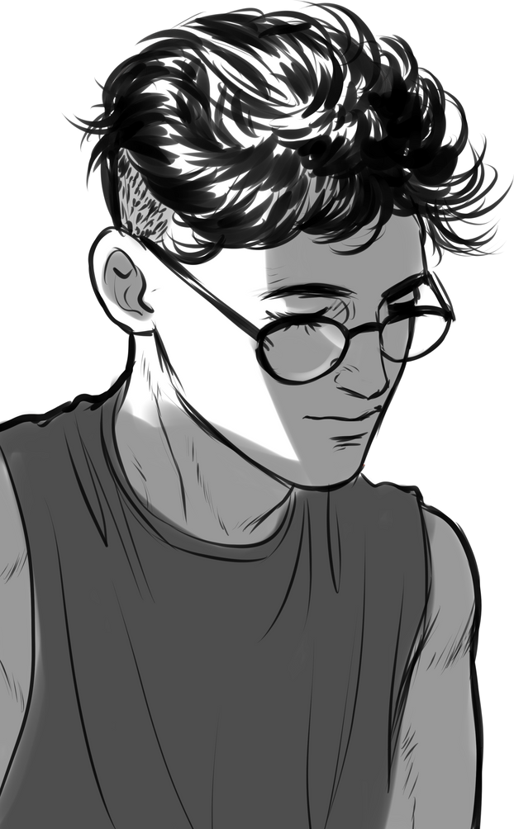

Problem Statement
The Challenge: Manga content on the internet often contains mature or NSFW (Not Safe For Work) themes, which are unsuitable for children and sensitive audiences.
Why It Matters: This creates a risk for younger audiences and requires a safe approach to accessing manga content.
Solution: An authentication is done as the user signs in and the model detects the NSFW content and puts an age restriction pop-up.

Slide 3
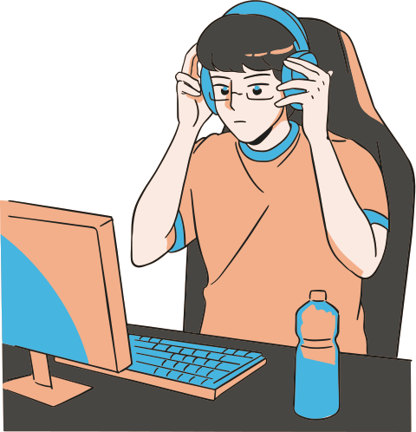



User Interface and Experience
Two-Sided Design: Manga Mania caters to both readers and content creators.
Reader Interface: Features a clean, intuitive layout with customizable settings, allowing users to easily discover and enjoy manga. Includes search, recommendations, and genre-based browsing.
Uploader Interface: Provides a simple, step-by-step process for uploading manga. Features tools for creators to manage their content and flag NSFW material to ensure compliance with community guidelines.
Safety Measures: We ensure a safe environment by restricting access to flagged content, implementing age verification, and monitoring for compliance.

Slide 4



Data Flow
User Detail
Genre
Detection
UI
Authentication
Request
Language
Detection
3
Lab
-els
Server Response
OCR
UI
Dashboard
NSFW
Detection
Model

Slide 5




Dependencies
UI:
Language:
Dart Flutter, html , css
Backend:
Language:
Python
Libraries :
Tensorflow , Automodel , FastApi
Database and server :
Cloud , MongoDB , Nodejs
Other frameworks :
Google Colab , Jupyter notebook, VsCode , Canva

Slide 6

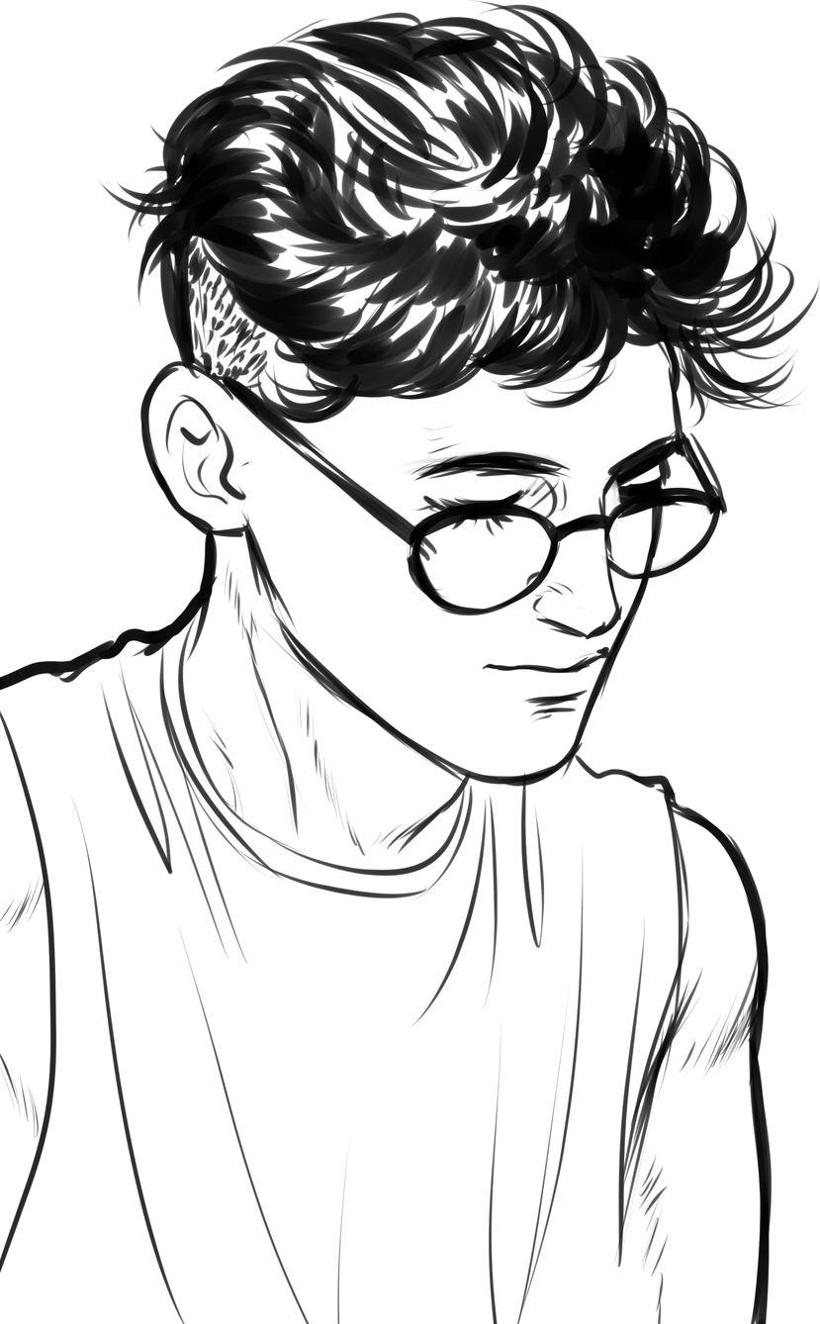
Future Scope
User Profiles and Social Interaction: Allow users to create profiles, follow other users, and engage in discussions or reviews.
Comments and Reviews: Enable users to leave comments or reviews on manga to foster a sense of community.
Monetization: Offer premium subscriptions with additional features or exclusive content.
Shared Projects: Allow creators to collaborate on manga projects, with features for version control and shared editing.
Interactive environment: Allow users to engage in reading mangas collectively through voice calls and video calls.

Slide 7

Thank You!

